Slide 1
Fake News Detector
Rashmi R - 19BCS067
Kiruthika P - 19BCS077
Bhavika Arage - 19BCS079
Josphine Cynthia - 19BCS092

Slide 2
Problem Statement
With recent booming of social media, users can get infected by fake news easily, which has brought about tremendous effects on the offline society already. Consumers are creating and sharing more information than ever before, some of which are misleading with no relevance to reality.
We have tried to implement a solution to classify any given news as fake or real using the latest machine learning technique for natural language processing pre-training - BERT (Bidirectional Encoder Representations from Transformers)

Slide 3
Components
We have used
a virtual gpu,
google colab and
bert models.

Slide 4
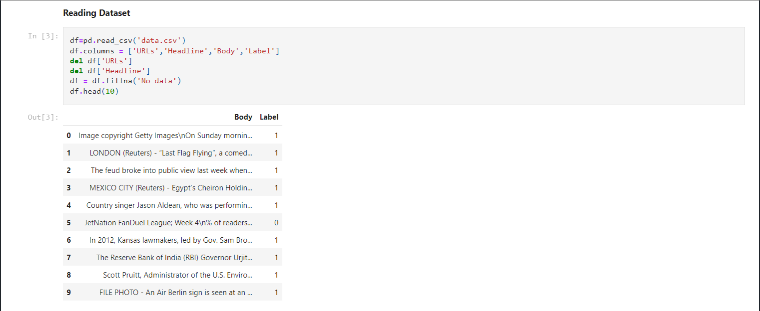
How we implemented
Cleaning the Dataset

Slide 5
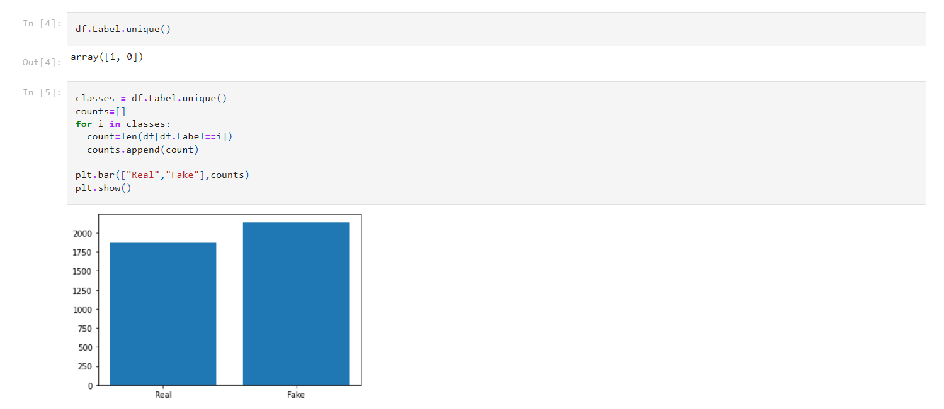

Slide 6
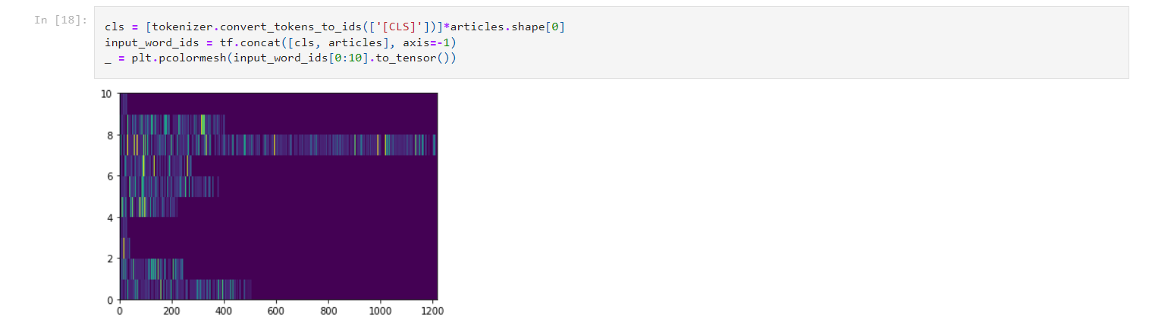
We declare the bert tokenizer and tokenize the text. The 3 input required for a bert model are tokens, masks and input type.
Tokens (into ids)

Slide 7
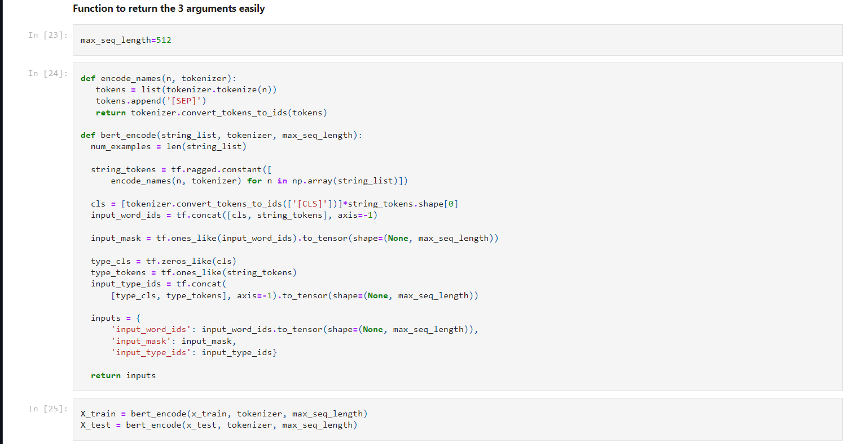
Function to get the input into the right format for bert model

Slide 8
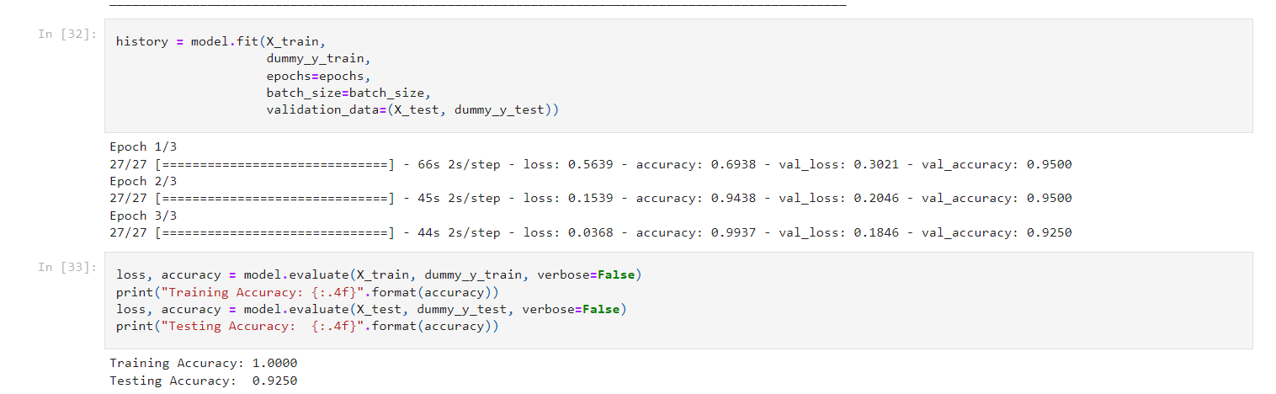
Training the model and getting the accuracy

Slide 9
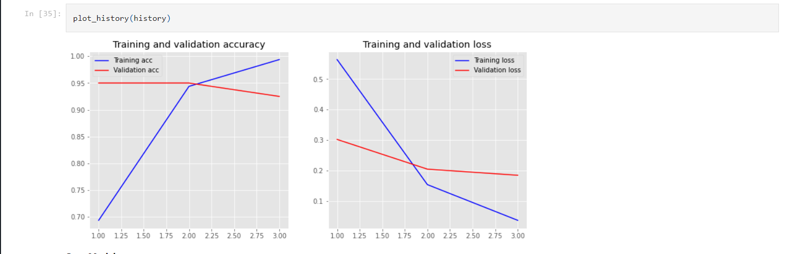
Graph for accuracy

Slide 10
Future Plans
Train it on a different and bigger datasets to get more accurate results.
Try a different bert model.

Slide 11
Thank You!

